Slide 1
Young Microbiologists Need Models, Not Critics
John Wain, Noemi Tejera and Dipali Singh,
Quadram Institute, Norwich Research Park, UK

Slide 2
Ongoing Projects at Quadram
Metabolic modelling group
QIB and Oxford-Brookes
How do bacteria cause cancer in humans?
How do I grow non-culturable bacteria?
Can we use metabolic ability to cluster bacterial isolates into biologically relevant groups?
Is metabolic ability involved in prosthetic joint infection for non-aureus staphylococci?
What is the metabolic basis for niche adaptation? E.g UTI
Why is Campylobacter oxygen dependent and oxygen sensitive?
What is the metabolic function of genes shown to be important in biofilm formation?
What is the metabolic basis of survival of Campylobacter?
What my group does
Generate or upload genome sequences
Update annotation – need genes linked to enzymes linked to reactions to build the network
Build the Genome Scale Model
Balance the model
Curate the model with experiments
Seek out collaborative research projects to exploit the model
Blue – within MFC; yellow collaborations; red outline needs external funding

Slide 3
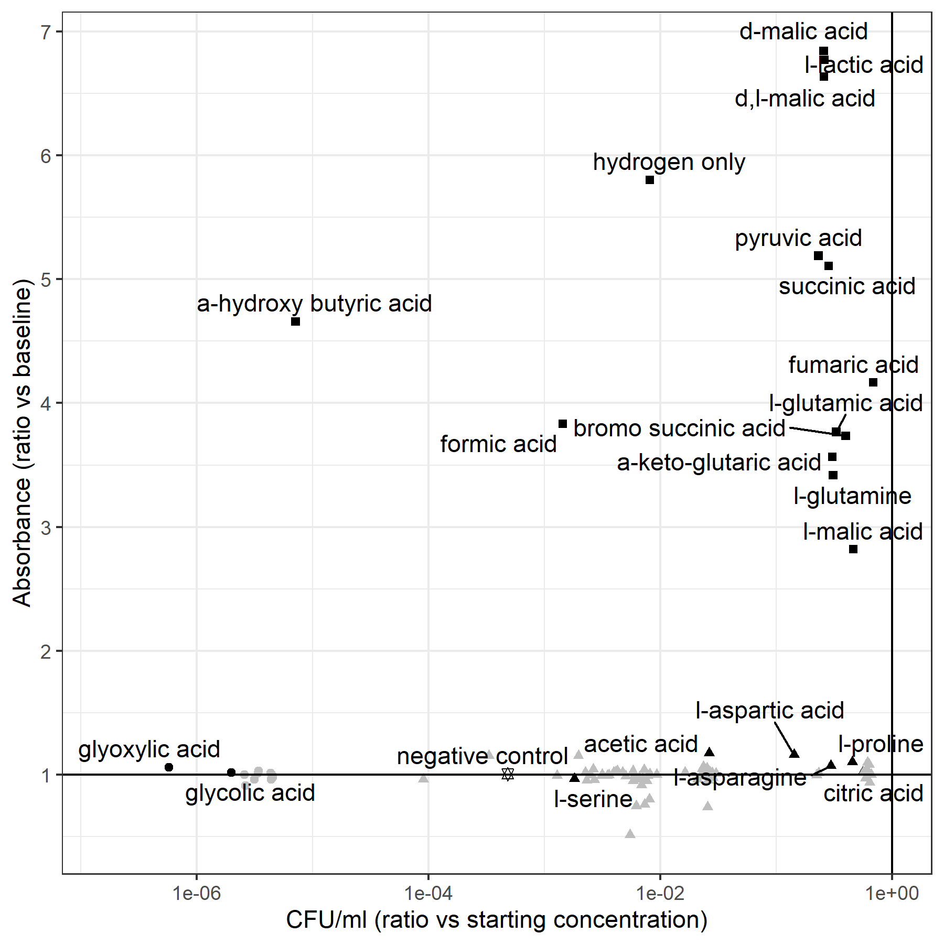
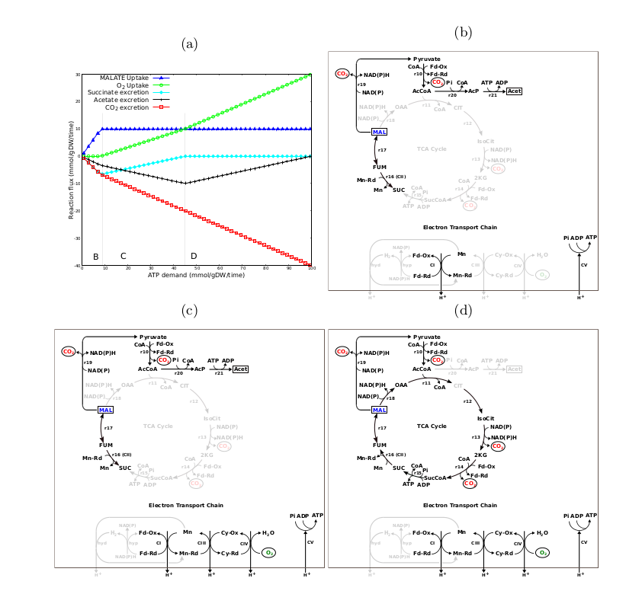
Campylobacter jejuni M1 can metabolise several BioLog substrates as single carbon/ energy source
Changes as ATP demand is increased
Many alternative routes for energy metabolism to allow survival
Biological advantage in a wide range of environments
Death 100% survival
This is of practical importance because organic acids, such as malic acids, lactic acids and acetic acids are commonly used as acidulants and as permitted food-additives can also be used as food preservatives. To remove Campylobacter from food we need to look at non-growing cells
Notes:
ATP scan reveals several different modes for ATPm production – from anaerobic

Slide 4
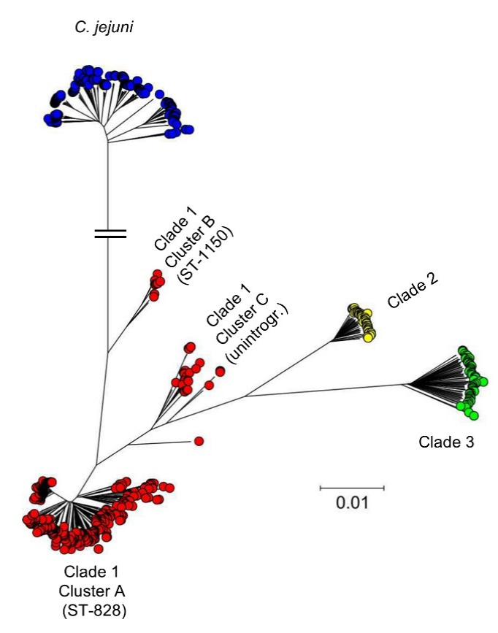
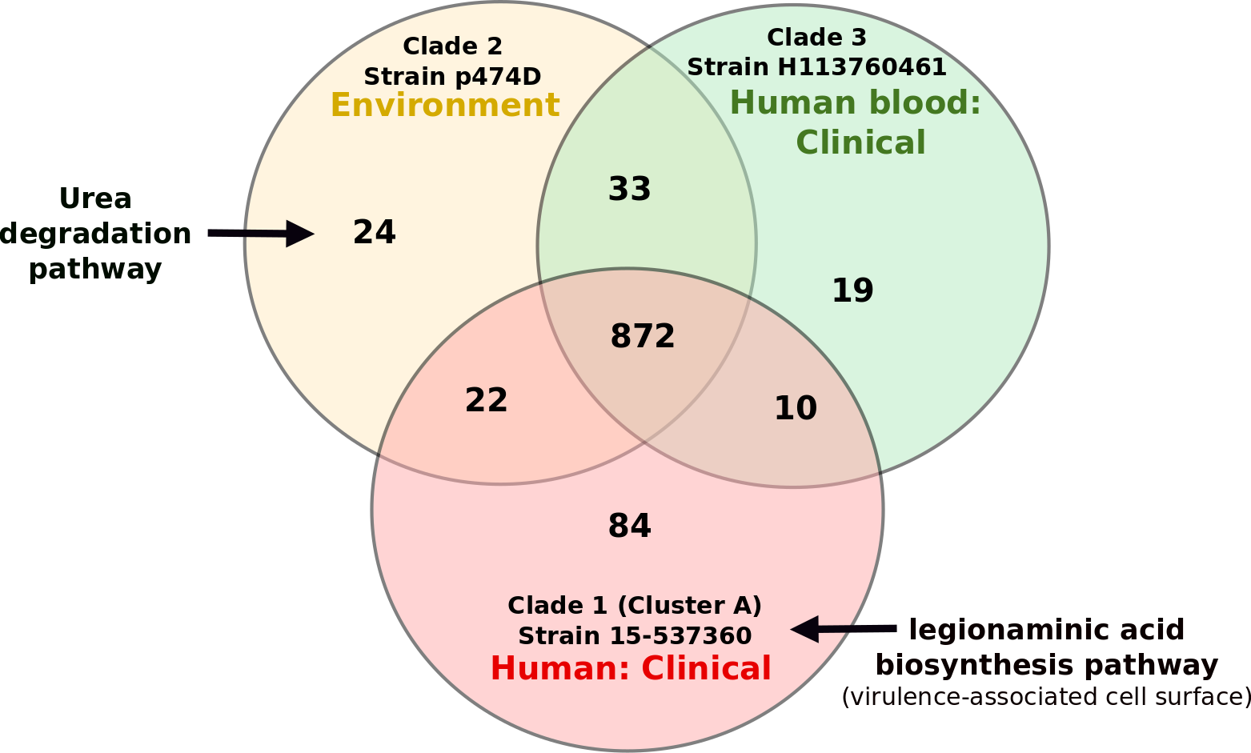
Metabolic Models for Campylobacter
Core and pan-metabolic capabilities
Examine metabolic differences between strains/clades
Explore niche adaption and auxotrophies of strains/clades
Source: Report FS101087, Oct 2016
No. of reactions unique to and shared between representative strains of each clades

Slide 5
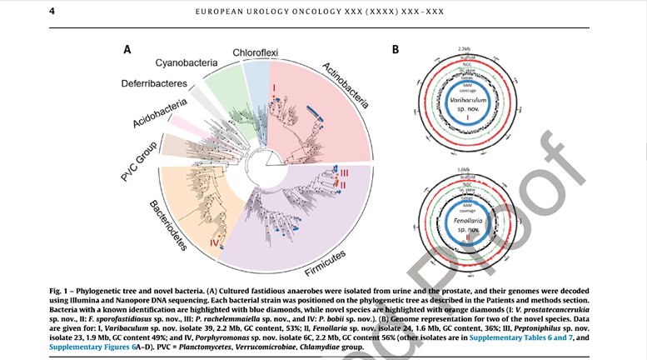
New ways to speciate bacteria - linking anaerobes to cancer
We (UEA/NHS/QIB) idented novel anaerobic bacterial sequence in urine deposits and linked them to progressive prostate cancer.
We isolated them and classified them using the “Tree of Life” approach (Figure).
Next steps – causality, what do the bacteria I the Table all have in common?
 | Breast cancer | Bladder cancer | Cervical cancer | Colorectal cancer | Endometrial cancer | Gastric cancer | Laryngeal cancer | Lung cancer | Oesophageal cancer | Oral cancer | Pancreatic cancer | Prostate cancer | Multiple types of cancer | References
Propionimicrobium spp. † |  |  |  |  |  |  |  |  |  |  |  | ∗ |  | [3]
Varibaculum spp. † |  |  |  |  |  |  |  |  |  |  |  | ∗ |  | [3]
Prevotella spp. ‡ | ∗ | ∗ | ∗ | ∗ | ∗ | ∗ | ∗ | ∗ | ∗ | ∗ |  |  | ∗ | [5-25]
Porphyromonas spp. ‡ |  |  | ∗ | ∗ | ∗ |  |  |  | ∗ | ∗ | ∗ | ∗ | ∗ | [1,23,24,26-31]
Bacteroides spp. ‡ |  |  |  |  |  |  |  |  |  |  |  | ∗ | ∗ | [32-34]
Fenollaria/Ezakiella spp. ∞ |  | ∗ | ∗ | ∗ | ∗ |  |  |  |  |  |  | ∗ | ∗ | [1,15,19,35]
Peptoniphilus spp. ∞ | ∗ | ∗ | ∗ |  | ∗ |  |  |  |  |  |  | ∗ | ∗ | [1,14,15,19,31,32,36]
Anaerococcus spp. ∞ |  | ∗ | ∗ |  | ∗ |  |  |  |  |  |  | ∗ | ∗ | [1,3,15,19,23,37,38]
Fusobacterium spp. # | ∗ | ∗ | ∗ | ∗ | ∗ |  | ∗ |  |  | ∗ | ∗ | ∗ | ∗ | [1,5,7,8,14,15,23,38,40-50,52]
Sneathia spp. # |  |  | ∗ |  | ∗ |  |  |  |  |  |  |  | ∗ | [15,23,37]
Microbiomes of Urine and the Prostate Are Linked to Human Prostate Cancer Risk Groups – Hurst, Meader et al - European Urology Oncology

Slide 6
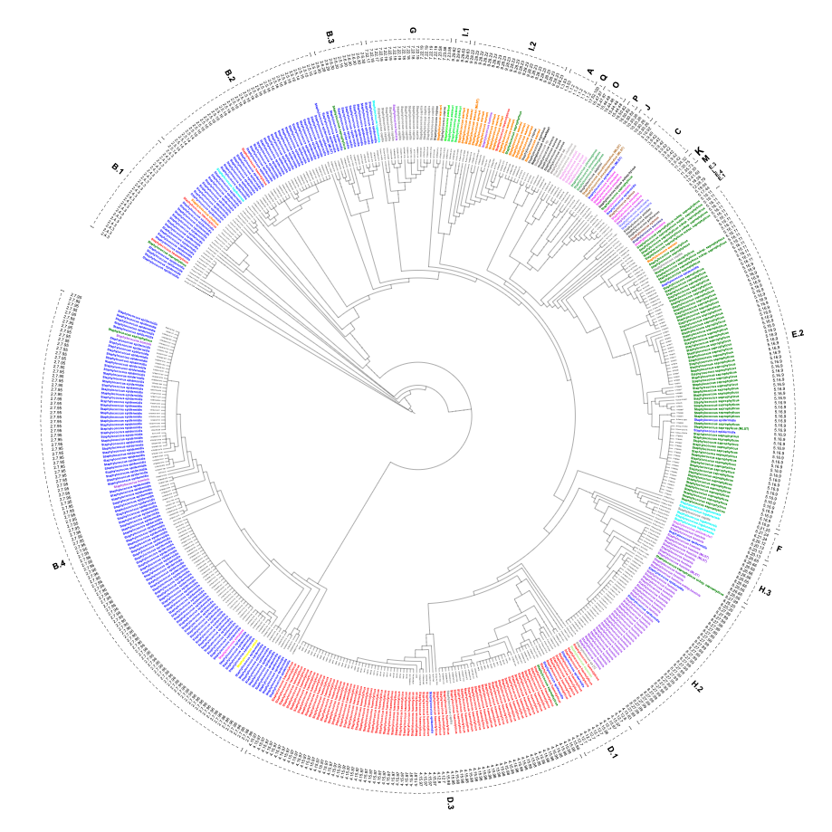
New ways to speciate bacteria – Staphylococci
Species are based on eukaryotic biology – reproductive isolation
Prokaryotes are not in reproductive isolation
Using ribosomal proteins present in all living organisms we can generate Robust Clusters (RCs) which almost match with species
Example Staphylococcus v gold standard identification
Tree is based on RCs (phylogenetic) colours are species (phenotype)
Some species are robust – some are mixed and some are a mess

Slide 7
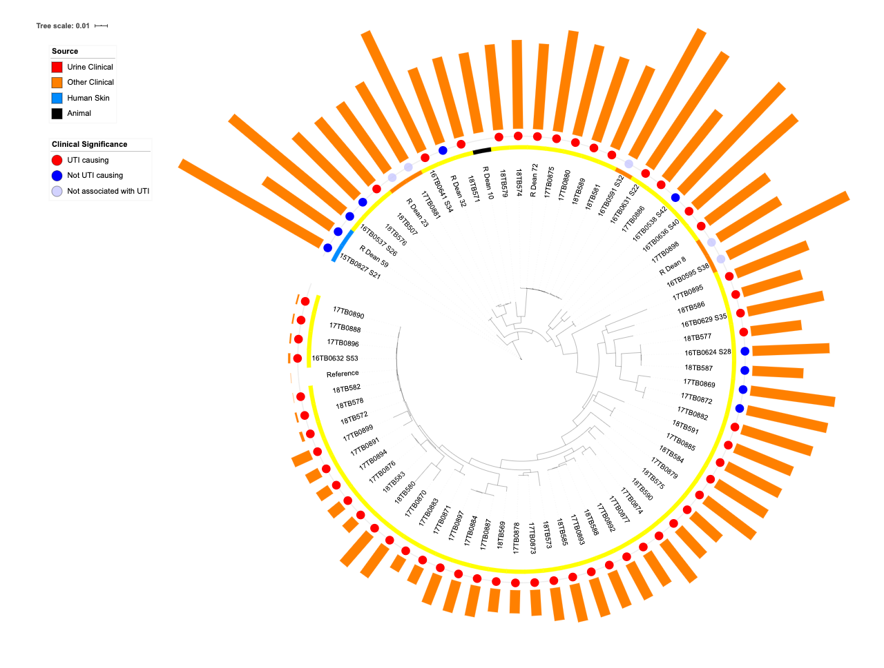
Once biologically relevant sub-groups are defined comparative genomics becomes much easier
group_1311
bsaA_2 Glutathione metabolism – there is around 85picoG of glutathione in urine
group_1292
asp2 linked to the serine-rich repeat (SRR) glycoproteins
group_1313
group_1314
group_1312
group_1299
arsB_4 The arsA and arsB genes of the ars operon of R-factor R773 confer arsenite resistance in Escherichia coli by coding for an anion-translocating ATPase. – widely seen in Staph
group_1304
Converting gene these lists into something useful will involve understanding the impact of each gene product – our current hypothesis is that Staph sap is adapted to live in the gut. Unusual for Staph.
Within Staph sap there are subgroups with varying virulence for the human urinary tract

Slide 8
A hundred years of “culture” Salmonella

Slide 9
Sequence typing with whole genomes
Isolate or sequence received – information checked
HG3 isolate?
Definitive testing
1d
DNA extraction in CL3
HG3 isolate?
Rapid serology for HG3
phagetypable?
Yes
HG3 isolate?
HG3 with serotype
phagetypable?
Phage-typing
PCR
phagetypable?
Subs I
Type defined
New ones
MLST profile known?
Phage-typing or biotyping
Phage-typing
Serotyping
Phage-typing
Serotyping
Type defined
Type defined
3-5 days
Serotyping
Biochemistry
7-10d
3-5 days
Biochemistry
3d
3-5 days
7-10d
7-10d
phagetypable?
phagetypable?
Central Public Health
Database – SNP typing
Reporting of serovar; ST; SNP address (core genome)

Slide 10
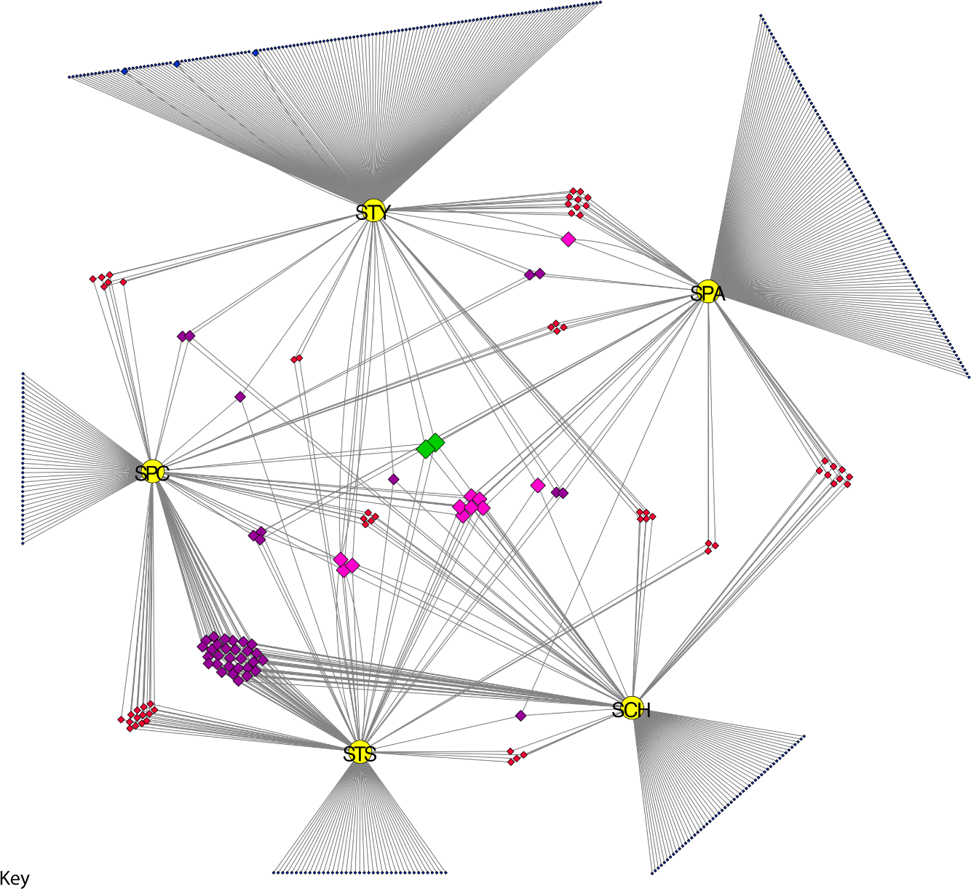
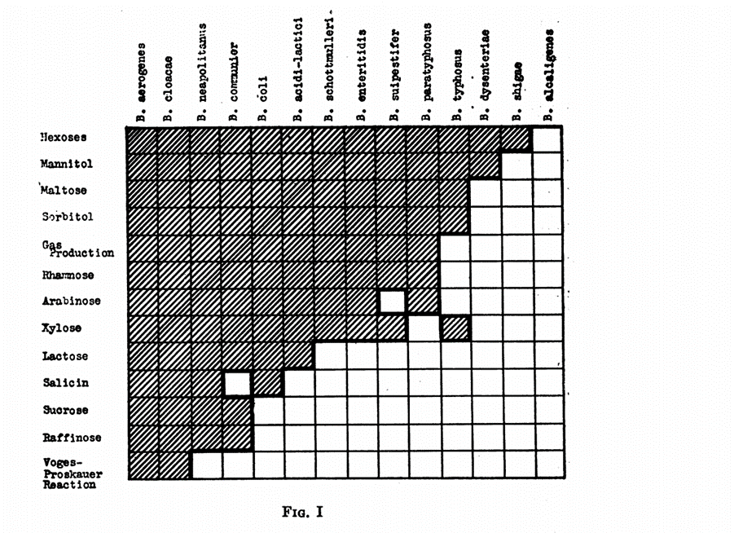
Biologically relevant sub-groups - again
Winslow 1919
Present in 1 serovar
In 2 serovars
In 3
In 4
In 5
S. Paratyphi C is pig adapted
Host adapted salmonellae are metabolically limited
Langridge 2017
Out with the new – in with the old, the new old.

Slide 11
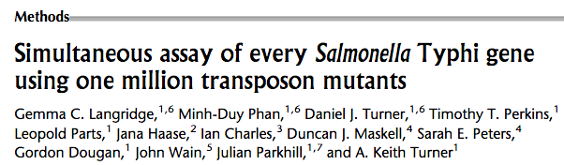
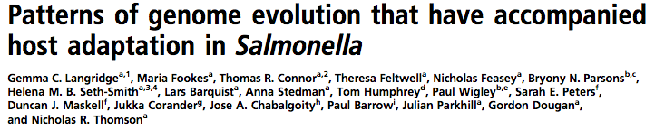
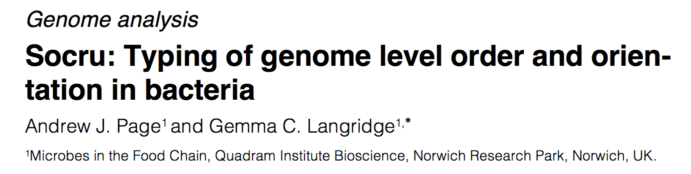
Bacterial diversity is generated in many ways
Quadram
Chronic S. Typhi carriage
Quadram
Public Health
England
Genome structure
and rearrangement
Bangladesh
Change of function
Sanger Inst.
SNPs, indels
Public
Health
England
Metabolic networks
Gen Res 2009
Oxford Brookes
Quadram
SNPS are just one, easy to measure, aspect of bacterial variation
PNAS 2015
BioRxiv 2019
Gemma Langridge

Slide 12
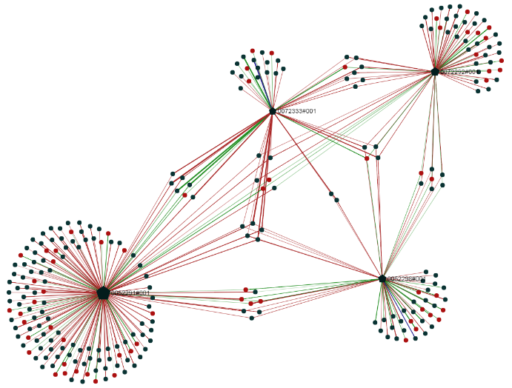
Quantitative transposon insertion data defines competitive survival
Network analysis can define “survival genes” for antibiotic exposure
Identified the genes involved in antibiotic resistance.
Showed that antibiotic resistance is a survival response and some combinations of antibiotics are less likely to develop resistance.
Next step flux-balance analysis but no renewal because of exit (Discuva Ltd)
Z
X
Antibiotics
Y
Non
-
essential gene
Essential gene
Upregulated gene
Disrupted gene
A
B

Slide 13
REFRESH – E.U. project to develop bacterial strains for the “valorisation” of food waste
Identified key genetic features of bacteria suitable for growing on a mixture of putrescible waste…
… further steps required to explore candidate chemicals for prospects of production
e.g: bioplastic PHB production.
Essential genes identified in Pseudomonas fluorescens cultured in putrescible (sandwich) food waste
PFL2_0037 trpB tryptophan synthase beta chain
PFL2_0302 hyp hypothetical protein PVLB_24070
PFL2_0944 unk proline dehydrogenase superfamily protein
PFL2_0947 unk major facilitator superfamily protein
PFL2_1020 ptsH phosphocarrier protein HPr
PFL2_1026 ostA organic solvent tolerance protein
PFL2_1398 ompH outer membrane protein OmpH
PFL2_1412 LysR putative LysR-family regulatory protein
PFL2_3614 hyp secretin
PFL2_3615 ipsJ isocitrate lyase
PFL2_3842 unk response regulator/EAL domain protein
PFL2_3843 unk sensor histidine kinase/response regulator
PFL2_3849 hyp hypothetical protein PFLU4059
PFL2_5547 ptsP phosphoenolpyruvate-protein phosphotransferase
We (Bactevo Ltd) selected Ps. strains that will grow on food waste and identified all of the genes required for biomass production We then found other strains with Phb genes capable of converting food waste into precursers for bioplastics
Next step modelling – but no renewal because we couldn’t find anyone with the skills needed.

Slide 14
What use metabolic modelling in microbiology?
My experience
Converting gene lists in to something useful
  Everyone get’s this and microbiologists want to work with us – expanding field
Maximising production of high value products
  Ten years ago there was no real UK market for bioproduction – hopefully better now
Dealing with waste
  Not commercially viable - yet
Creating bacterial clusters to allow understanding of “species” or biology of a group
  This is in silico phenotyping but it challenges the species concept – not liked
  We are starting to use it to define traits in food-borne pathogens/ microbiota from metagenomics
Looking at interactions
  Building models of communities rather than single cells – currently has a credibility issue
  Looking at the interaction between host and microbe – very hot area of research

